Slide 1
NOAC 2024
62 Delegates NOAC is Full!!!
Tahosa Lodge Contingent
NOAC 2024 Chair: Alex Diggins
NOAC 2024 Adviser: Lorraine Patton
(720) 409-2690
Patton4family@gmail.com

Slide 2
FEBRuary 18, 2024 Agenda
Housekeeping
Contingent Payment Update
Committee Reports
Other Fundraising
Get-Together
Get Excited ! ! !

Slide 3
Housekeeping
Tahosa Lodge 2024 Dues Dues must be current for NOAC. Also for you to receive emails from Lodgemaster.
Arrow ID All communications from the Lodge depend on the info entered in Arrow ID to be correct and up to date.
BSA Med Forms A, B, C NOAC requires we provide BSA Med Forms A, B1, B2 signed, and C signed. Prepare 2 copies to give to the contingent leadership for NOAC.
YPT Certification All delegates 18+ years old must have completed their YPT certification in the year prior to NOAC. This means it needs to be dated August 5, 2023 or later.
Slack We will use to communicate before and during NOAC. Committees can communicate and collaborate. Invitations have been resent to those that have not accepted yet. Please set up Slack on your phone.

Slide 4
Contingent Payment Update
Delegates Paid in Full:
$200 Contingent Fee & $625 Conference Fee
Final Contingent fees to be paid:
$150 Due 3/5
Final Payment Up to $150 Due 5/5
Waitlist Delegates have paid based on Conference Fee Selected:
$625 Discount Contingent Fee paid to hold spot in NOAERs
$100 Standard Conference Fee paid to hold spot in NOAERs
ALL Delegates that are added to our Contingent from the NOAERs Waitlist will owe the total amount due to the Contingent at that time!
4 - LP

Slide 5
Activities Committee
Itinerary Update:
Saturday July 27th
Meet at Elitches (Meal Ticket for Lunch) → Aquarium (Dinner)
Sunday July 28th
Cheyenne Frontier Days (Lunch & Dinner)
Monday July 29th
Denver Mint Tour OR Zoo → Lunch → NOAC Conference
Still working out details . . . and determining with Hospitality if this is a viable itinerary based on costs.
5 - AD

Slide 6
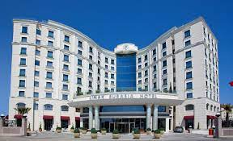
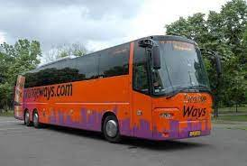
Hospitality Committee
Hotel:
2 Queen Beds/Room 4 Youth/room OR 2 Adults/room
Breakfast Included
Near I-25 & I-70
Transportation:
2 x GCC 15 passenger Vans
A Truck to Pull OA Trailer for luggage
Bus OR 3 more 12 pax Vans for 50 ppl
Food:
Venue dependent
Will let Delegates know which meals to bring cash for
6 - LP

Slide 7
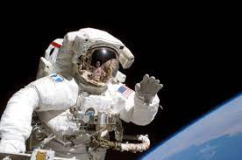
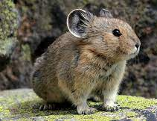
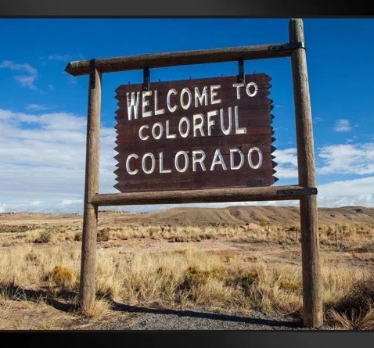
SWAG Committee
Seek New Heights
Home of SpaceForce
Theme: Space Force
Colors: Navy Blue, Silver, Lite Blue, Orange & Purple
Ghosted Flap Themes: CO Flag & Welcome to Colorful Colorado
Verbage: NOAC 2024, WWW, Tahosa Lodge 383, Seek New Heights & Home of the Space Force
Back-up Themes: CO 14er’s or Skiing in the Rockies

Slide 8
SWAG Committee
Seek New Heights
Home of SpaceForce
SWAG Items:
5 x 3 Flap Designs
2 x T-shirt
1 x Polo Shirt
1 x Hat
1 x Water Bottle
12 x Carabeeners
3 x Stickers

Slide 9
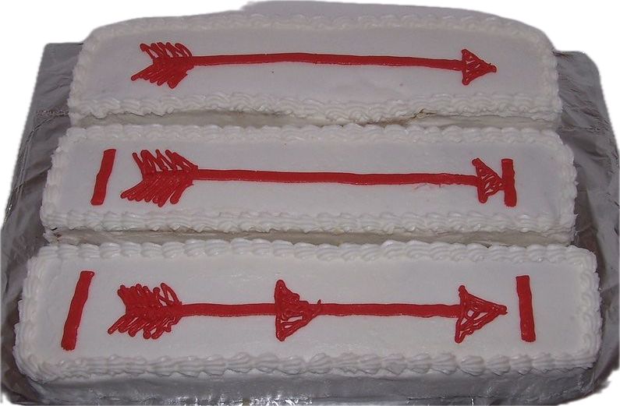
Cake Auction Participants
24 Cakes Donated - Raised $656 at our OA Banquet Cake Auction last night!!!
Sam Greene
Margaret Cranor
Alex Diggins
Logan Thwaites
Kate Patton
Joel Nishida
Cowan Dohrman
Harry Hughes
Will Holloway
Brayden Klutzke
11) Brooks Athen
Ryan Ausherman
13) Traye Scoville
$50/person was raised!
9 - AD

Slide 10
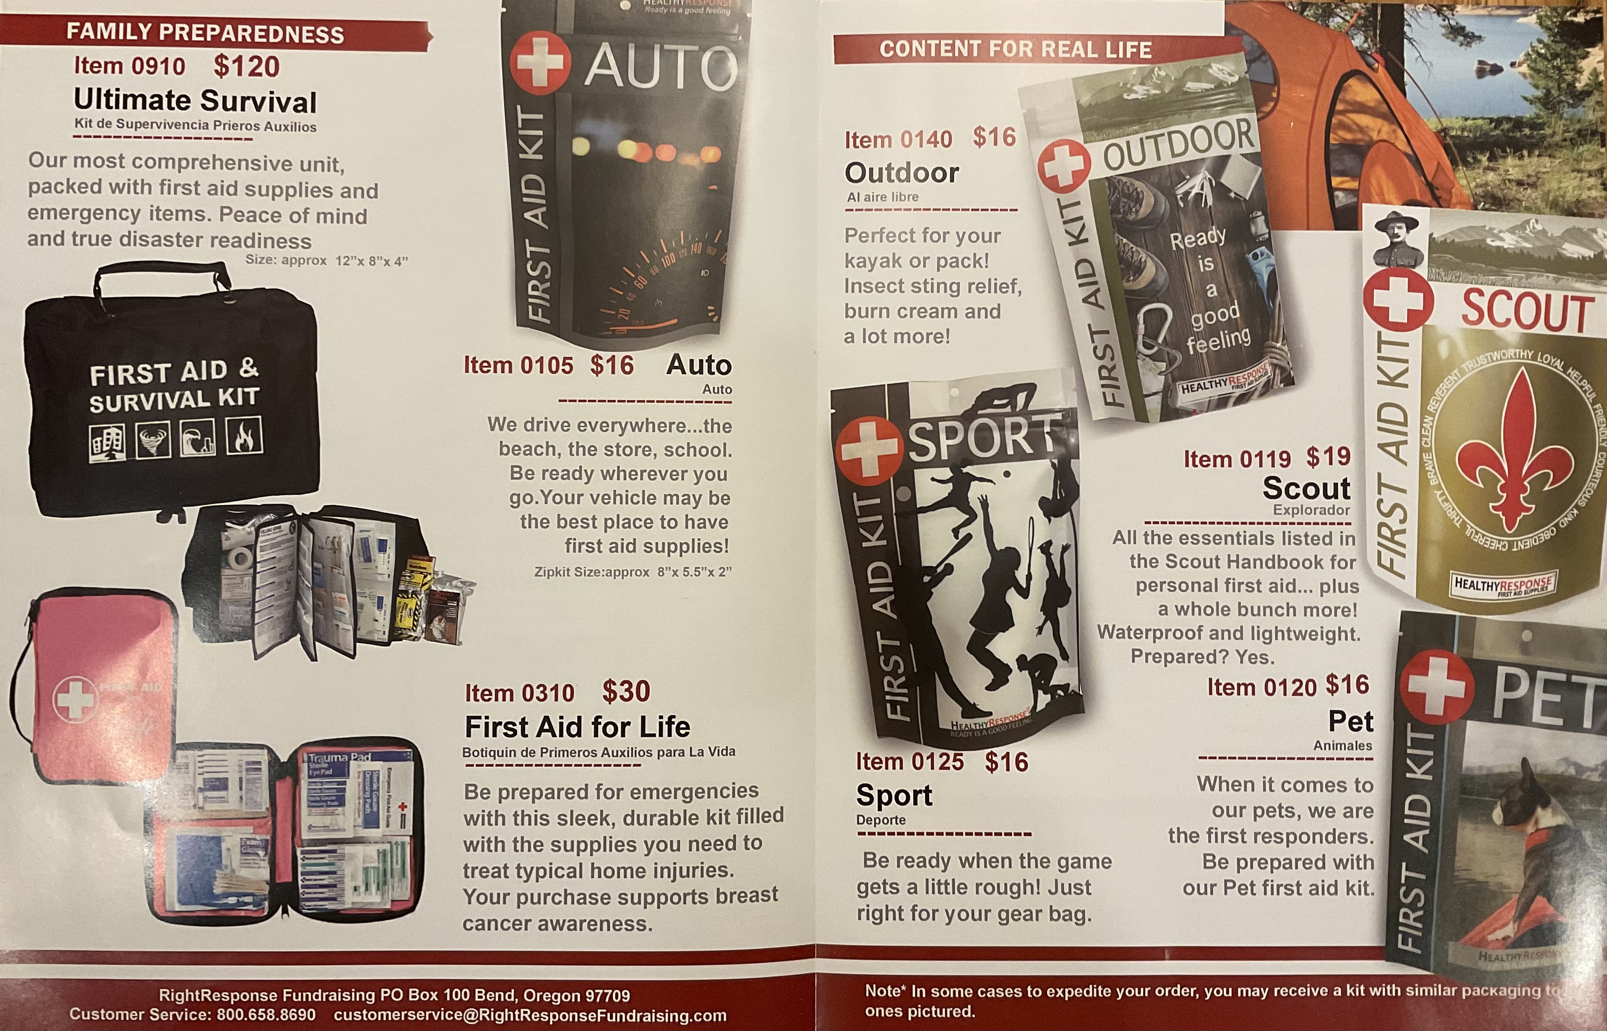
Fundraising
GCC Camp Cards
OA Banquet Cake Auction
BIG SUCCESS!!!
Everyone that participated
earned $50 towards NOAC
Right Response First Aid Kits
Online Sales Receive 40%
1 Email Address per Family
GCC Camp Cards
Sign-up Through Your Unit
Scouts have already earned $100!

Slide 11
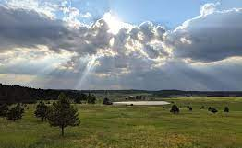
Contingent Get Togethers
Use the Sign-up Genius Link!
Please RSVP for Contingent Get-Togethers ASAP!
February 24th 6-9 pm
Bowling/Pool/Air Hockey/Food at Bowlero Englewood – bring $ to pay for what you want (after Polestar Training)
March 9th 6-9 pm
Meet at a Restaurant near I-25 & 6th (after Induction Planning Workshop) We need a head count to determine if our restaurant choice will work out

Slide 12
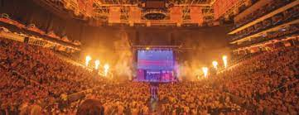
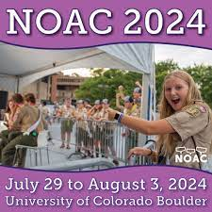
Get Excited!
Join a NOAC Committee
Update Your NOAERs Info
Meet Other Delegates
Choose a Buddy & Buddy Pair
Wear Your NOAC 2024 Patch
Get Involved with Tahosa
Attend Induction Weekends

Slide 13
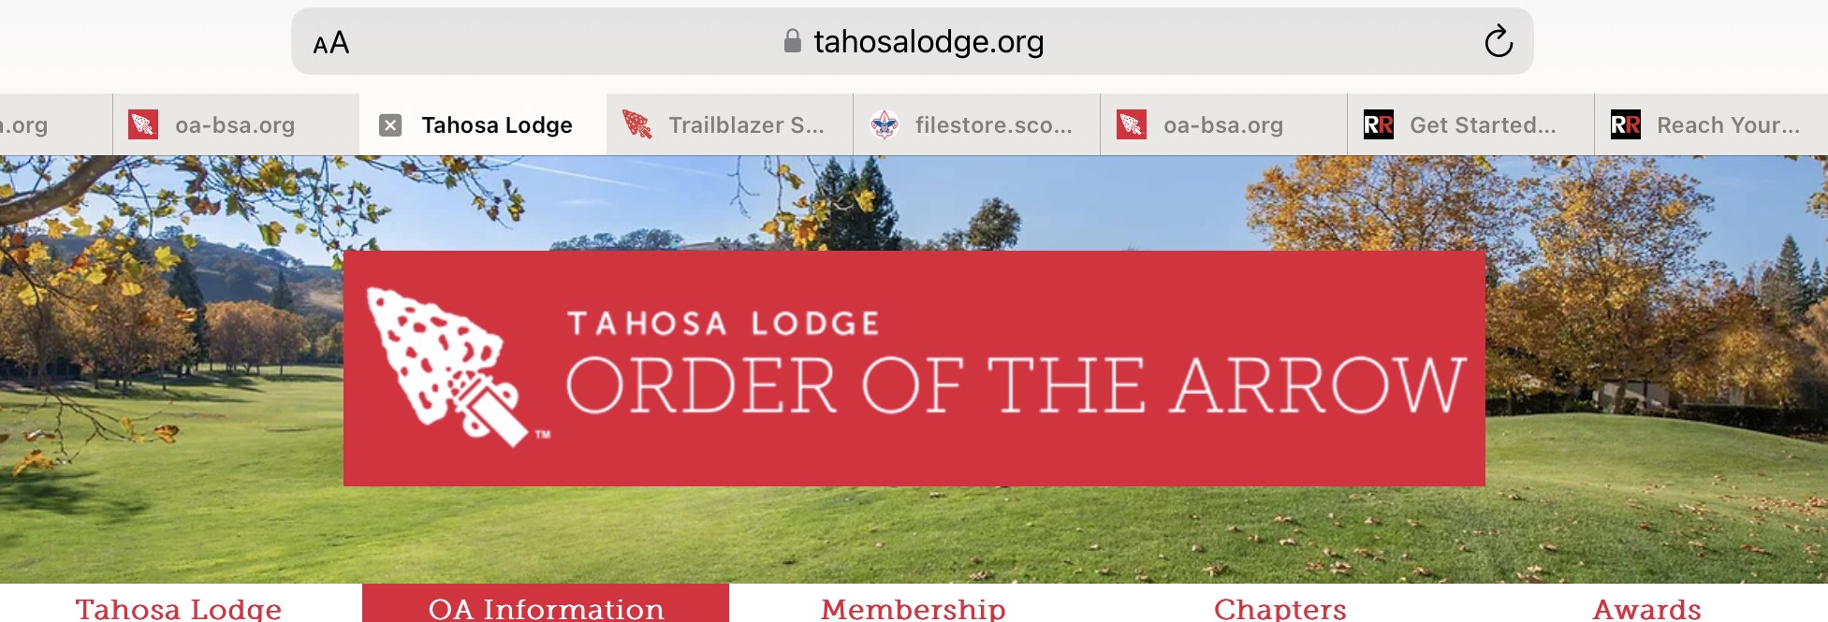
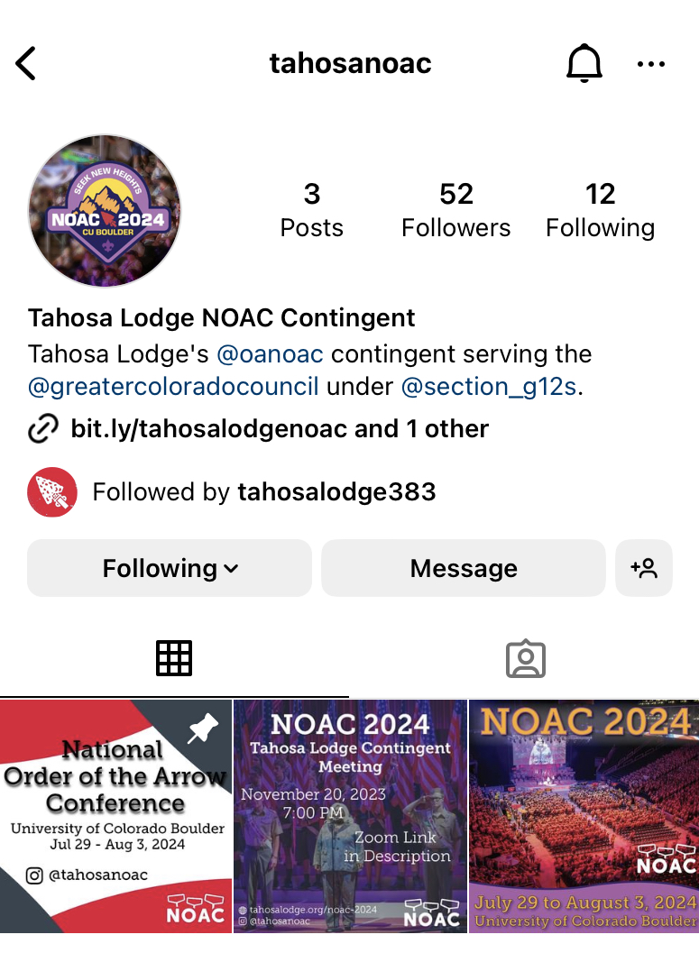
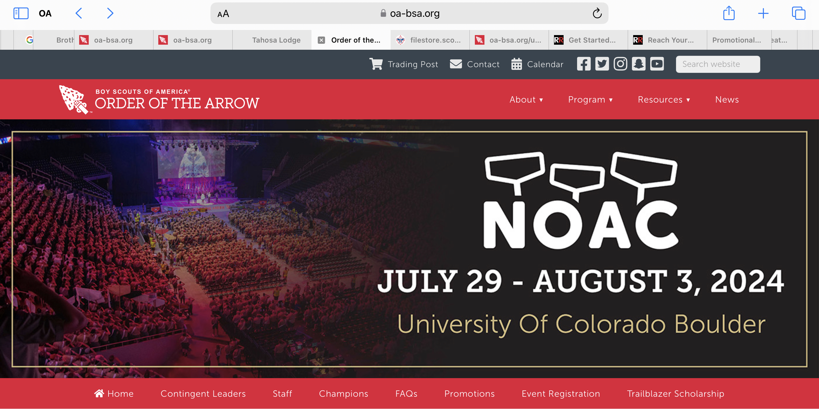
NOAC Info
Tahosa Website – NOAC Page
Doubleknot to make Payments
https://www.tahosalodge.org/noac-2024
OA NOAC Website
https://oa-bsa.org/program/events/noac
Instagram Handles
@tahosanoac and @oanoac
Lodgemaster Emails
Mass communications for the contingent
Contingent Communication
Slack App (for those Registered with the
Contingent)
NOAERS
For Registered Contingent Delegates to Sign-
up for training and activities at NOAC

Slide 14
Seek new heights together at NOAC 2024!
?’s
Next Contingent
Meeting
3/24 @ 7:00 pm

Slide 15
THANK YOU fOR YOUR tIME AND SUPPORT

