Slide 1
NOAC 2024
27 of 40 Discount Slots Paid in Full!!!
Tahosa Lodge Contingent
NOAC 2024 Chair: Alex Diggins
NOAC 2024 Adviser: Lorraine Patton
(720) 409-2690
Patton4family@gmail.com

Slide 2
January 14, 2024 Agenda
Housekeeping
Contingent Payment Update
Committee Reports
Other Fundraising
Get-Together
Trail Blazer Scholarship
Advertise

Slide 3
Housekeeping
Arrow ID All communications from the Lodge depend on the info entered in Arrow ID. Check email from the Lodge.
Slack We will use to communicate before and during NOAC. Committees can communicate and collaborate.
YPT: Change Your Name to Follow this Convention:
Age/Gender First/Last Name “YM Alex Diggins”
Must be YPT compliant – No 1-on-1, gender observant
Channels: NOAC General - NOAC Leadership - NOAC Links
NOAC Youth - NOAC Adults - NOAC Parents
NOAC Committees (Fundraising – Activities – SWAG – Hospitality)

Slide 4
Contingent Payment Update
Delegates Paid in Full ($200 Contingent Fee & $625 Conference Fee):
Brayden Klutzke
Ian MacMillan
Isaac Grissom
Joshua Sandoval
Traye Scoville
Warren Scoville
Joel Nishida
Xander Moss
9) Elliott Graham
Kate Patton
Lorraine Patton
12) Michael Patton
Ryan Ausherman
Ian Williams
Kian Wood
Charlie Duchmann
17) Alexander Athen
18) Gavin Almuti
19) Noah Parker
20) Allen Rutherford
21) Gus Rutherford
22) Declan Mahoney
23) Michael Boback
$825 is Due By January 31st
$200 Contingent Fee & $625 for the “Early Bird” Discount Conference fee
Final Contingent fees to be paid 3/5 and 5/5
4 - LP

Slide 5
Service Corps Update
New Procedure and Payment Structure in Place
If you are a youth and have previously attended a NOAC
Who to Contact:
If you have signed up through the Contingent please reach out to Mrs. Lorraine Patton
New interest may also contact Mr. Jim Moss
5 - LP

Slide 6
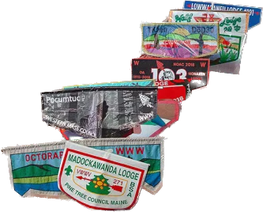
NOAC Committees
FUNDRAISING: Plan the OA Banquet Cake Auction and research other fundraising ideas for the Contingent.
ACTIVITIES: Research and gather costs for pre-NOAC activities that the Contingent can participate in based on interest from this survey.
SWAG: Collaborate, design and price various merchandise for the contingent to receive. Ideas will be narrowed down by this survey. This Committee has some of the most important due dates to get patch designs to production! Please be prepared to help finalize over Christmas Break!
HOSPITALITY: Based on the direction we go with our pre-NOAC activities this committee will plan and gather costs for transportation, accommodations, and food.
Looking for Youth Chairs for these Committees!

Slide 7
Activities Committee
Expectations for January Meeting:
Research the Activities in both Areas
Come up with an Itinerary for each Area – Time Allotted & Order
Identify Costs
Identify Waivers & Reservations or Down Payments
Google Form: Activities Poll
https://forms.gle/5hQa47NMJqvDtbDa8
7 - AD

Slide 8
Pre-NOAC Activity Ideas
1. Elitches amusement park. All day activity. About $25 per person, will be lower with a group price
2. Denver Aquarium. Half day activity. About $17 each for admission.
3. Denver Zoo. Half day activity. About $16 each for admission.
4. Denver Botanic Gardens on York Street. Half day activity. Students $9 and adults $13 for admission.
5. Meow Wolf interactive art exhibit. Half day activity. Regular admission $35 for each admission.
6. Colorado State Capitol, one and a half hour tour, free
7. United States Mint, one and a half hour tour, free
8. Contingent camping trip at Vaholl Ranch. There will be patrol cooking, activities like fishing, archery, and
shooting. About $40-100 per person for the weekend.
9. Denver Adventures and Zipline Tours. Big zipline place in the mountains. $80 per person
10. Mine Tours near Idaho Springs/ Georgetown. 2-3 hr tour. About $15 to $32 each for admission.
11. Cheyenne Frontier Days. Full day activity. Admission based on quality of rodeo seats. ~$30
12. Rafting. $100
13. Mountain biking. Around $100 depending on rentals and location.
8 - AD

Slide 9
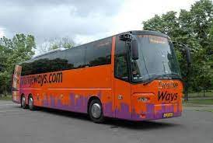
Hospitality Committee
Expectations for January Meeting:
Research the Types of Transportation for each Area – Bus, Van, etc.
Provide Costs for each Solution by Capacity
Identify Waivers & Reservations or Down Payments
9 - AD

Slide 10
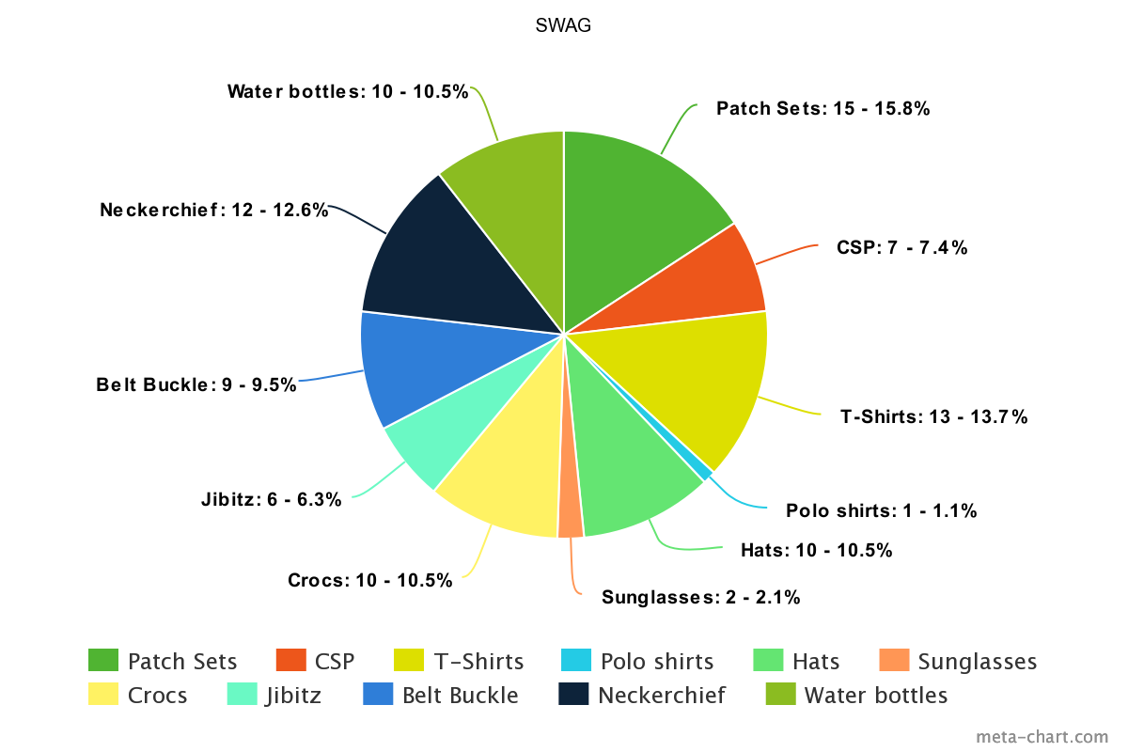
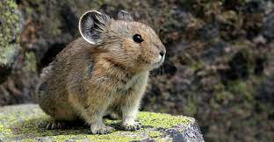
SWAG Committee
Expectations for January Meeting:
2-3 Designs Prepped for January Meeting Vote
Research the Types of SWAG and Cost Range for 50, 100, 200

Slide 11
SWAG Committee
Patch Design NEEDS to Happen Over Winter Break!
Theme: Seek New Heights
Colors: Orange & Purple
Ideas: Colorado 14er’s
Other . . .
Possible Vendor Collaboration: Otter Box or Chipotle

Slide 12
Fundraising Committee
Expectations for January Meeting:
Create Promotional Materials for Lodge to Participate (Email, Instagram)
Create a Sign-up Genius
Work with Activities VC to Put a Plan Together for the Cake Auction (Tables, Table Clothes, Program)
Work with Admin VC to Determine How People can Pay for Cakes

Slide 13
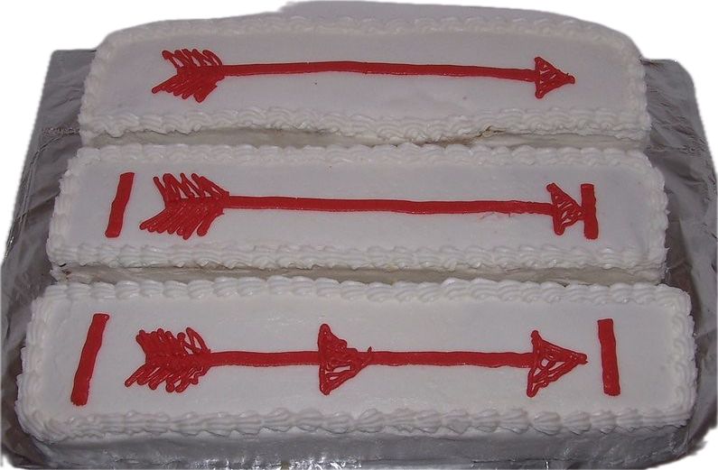
Cake Auction Participants
24 Cakes Donated - Raised $656 at our OA Banquet Cake Auction last night!!!
Sam Greene
Margaret Cranor
Alex Diggins
Logan Thwaites
Kate Patton
Joel Nishida
Cowan Dohrman
Harry Hughes
Will Holloway
Brayden Klutzke
11) Brooks Athen
Ryan Ausherman
13) Traye Scoville
Are we missing anyone?
~$50/person
Need to pay out expenses for table clothes and credit card fees. So we will get a final fundraising number for each delegate that participated ASAP and communicated!
13 - AD

Slide 14
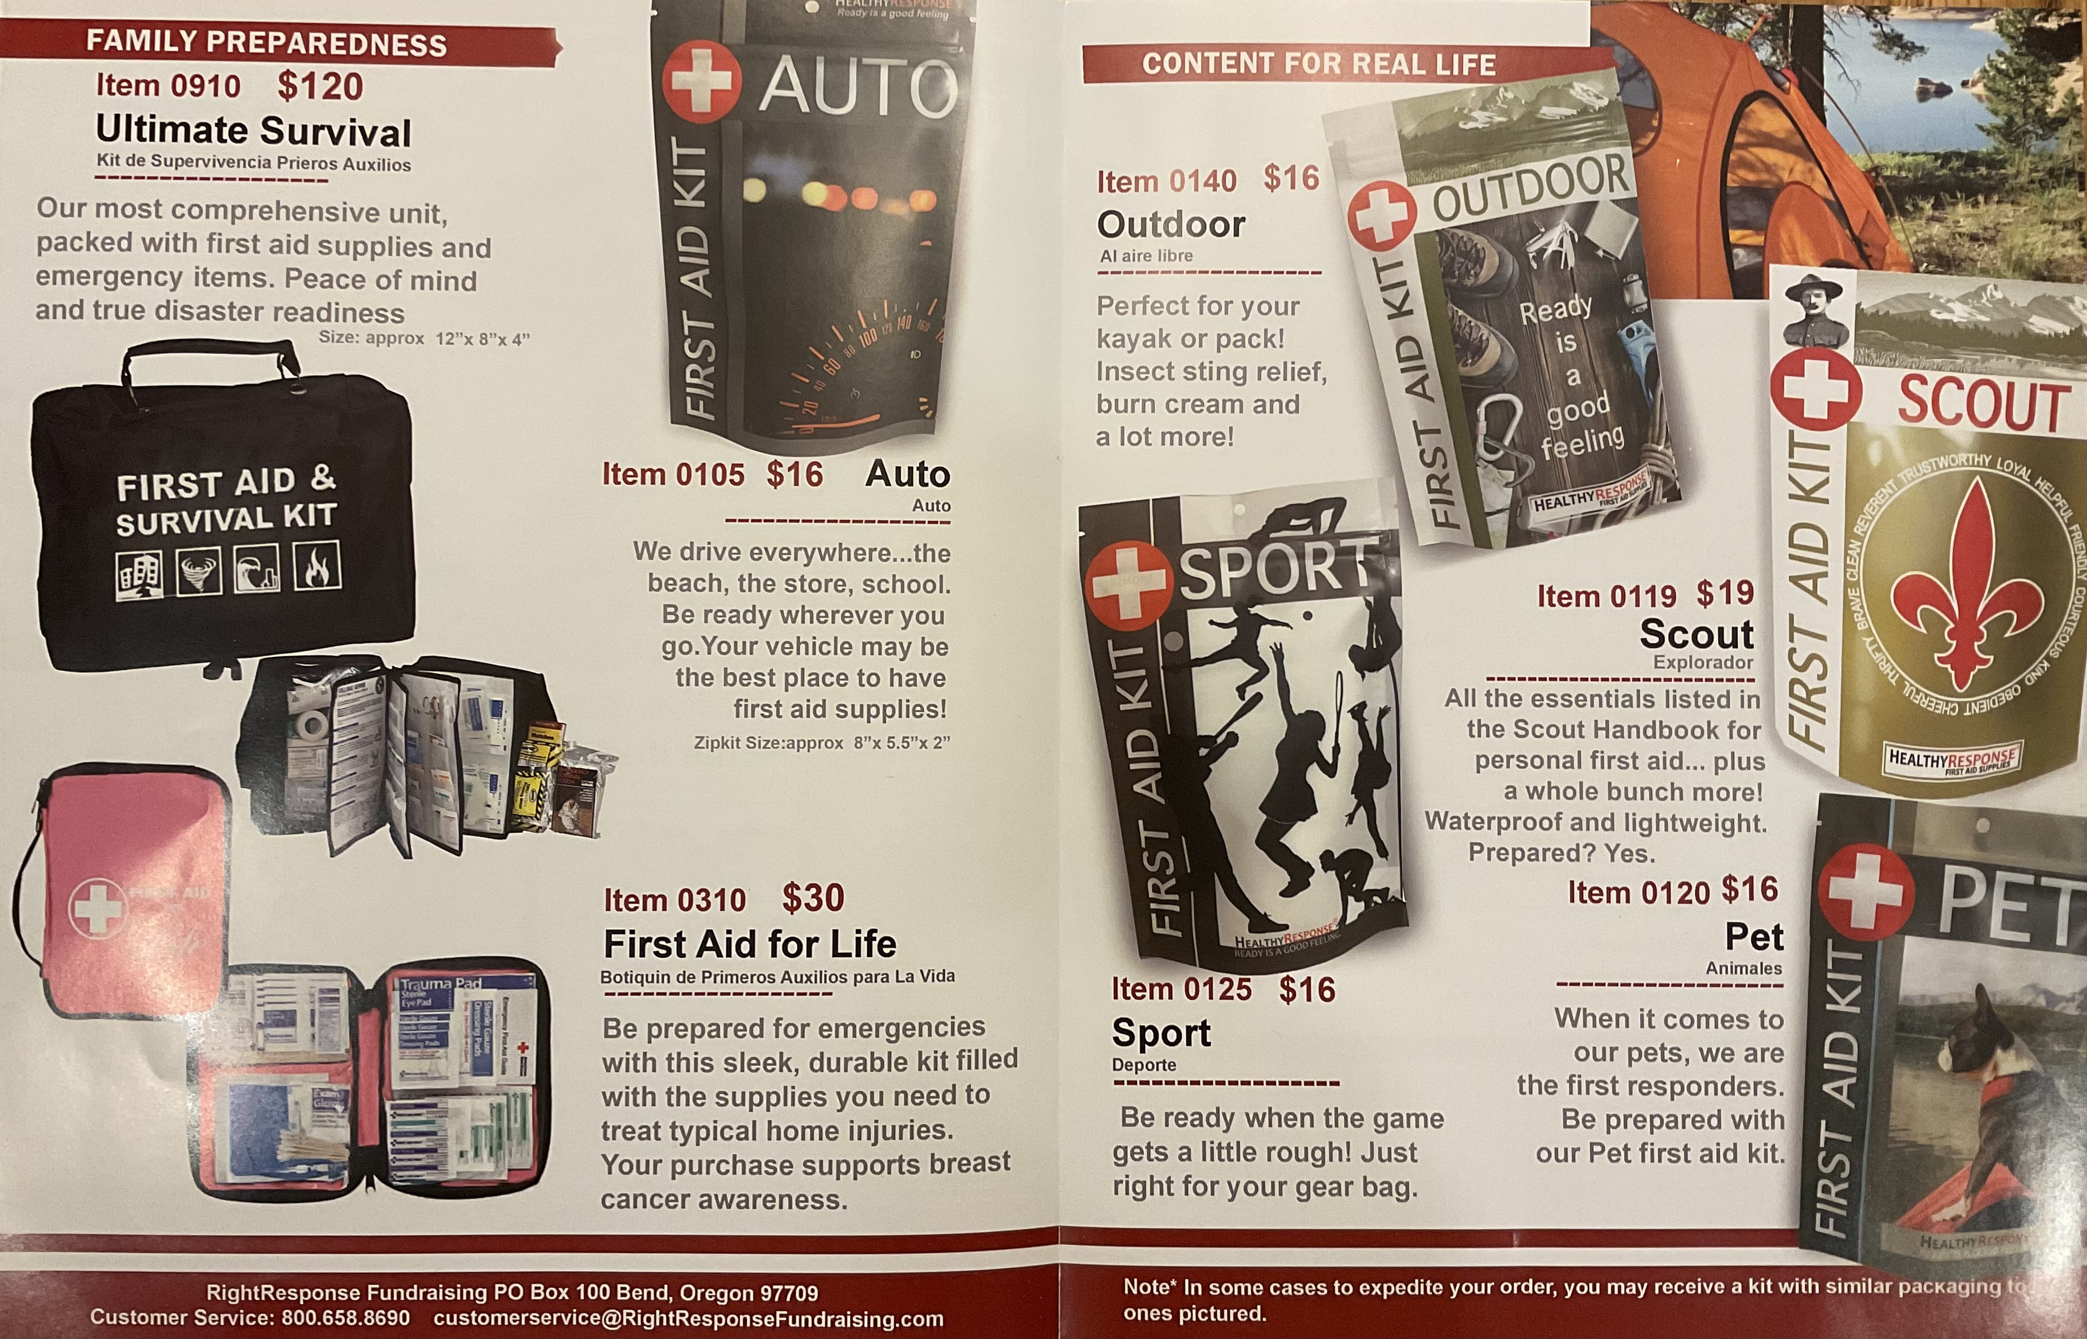
Fundraising
GCC Camp Cards
OA Banquet Cake Auction
BIG SUCCESS!!!
Everyone that Participates Gets
Divided Funds
Right Response First Aid Kits
Online Sales Receive 40%
1 Email Address per Family
GCC Camp Cards
Sign-up Through Your Unit

Slide 15
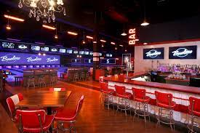
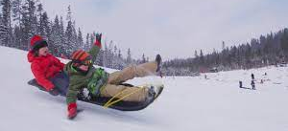
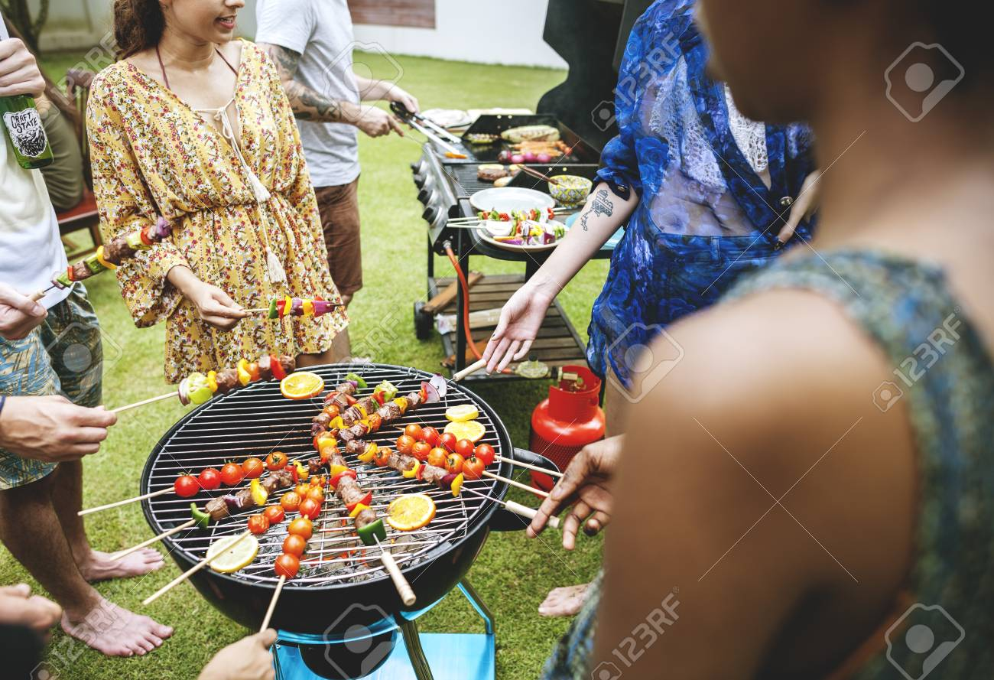
Contingent Get Togethers
January 27th
Ice Skating in Parker (after Elections & Chapter Chief Training)
February 24th
Bowling/Pool/Air Hockey near Scout HQ (after Polestar Training)
March 9th
Meet at a Restaurant off I-25 or I-70 (after Induction Planning Workshop)

Slide 16
Youth Applications due Jan. 31 https://oa-bsa.org/program/events/noac/trailblazer-scholarship Adult Sponsors Needed!
OA Trail Blazer Scholarship
The memorabilia package* includes the following special items:
- Trailblazer Neckerchief - Trailblazer Patch
- Trailblazer Chenille - Trailblazer Coin
- Trailblazer Pin
Every individual supporter of the Trailblazer Scholarship who purchases at least one memorabilia package AND registers to attend NOAC will be invited to an exclusive sponsor reception at the conference.

Slide 17
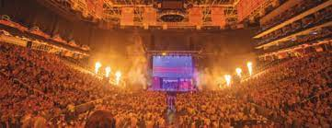
Advertise
Go Back to your Unit:
- Share Info with Your Scoutmaster
- Promote OA Elections in Spring
- Wear Your NOAC 2024 Patch
- Promote Attending NOAC
- Invite a Fellow Arrowman!

Slide 18
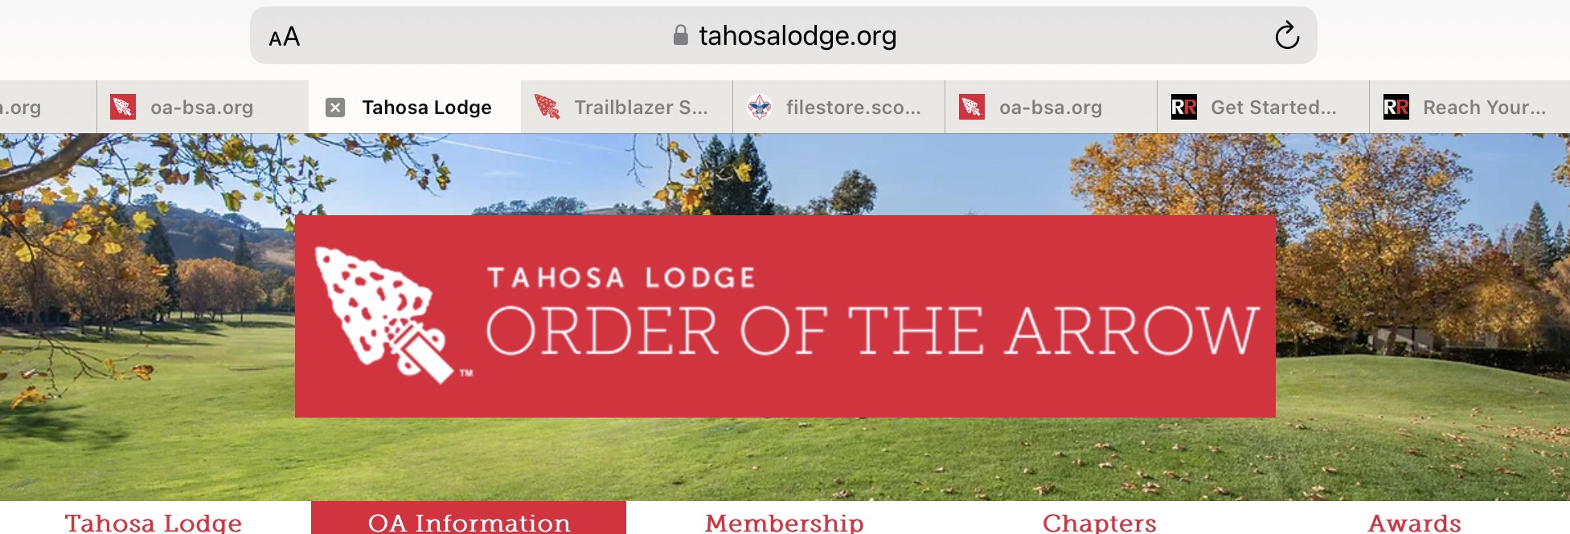
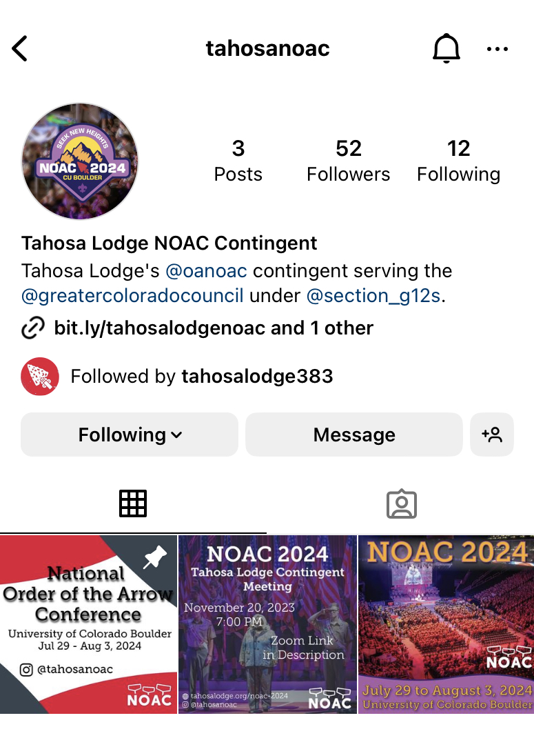
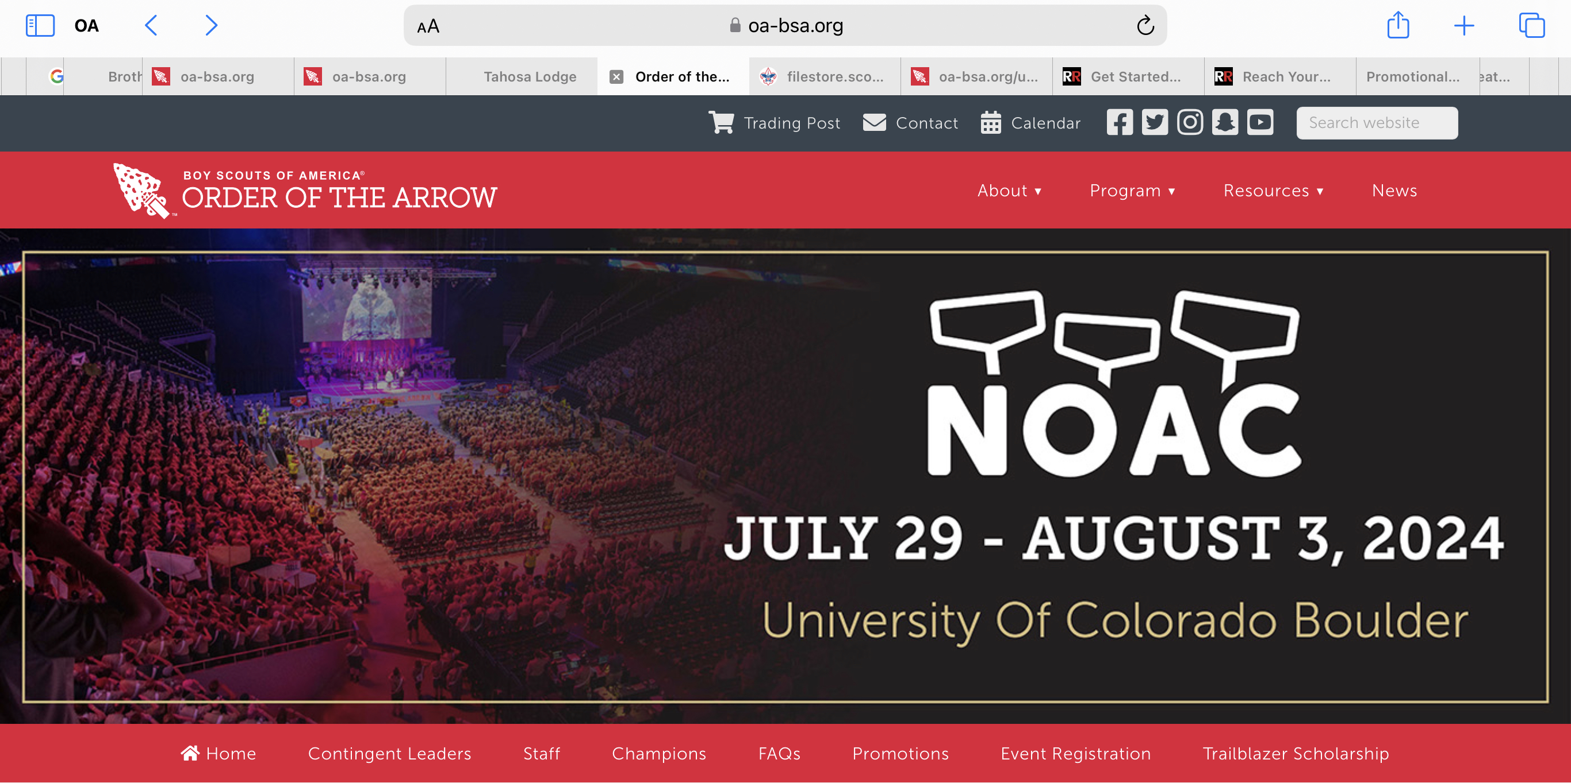
NOAC Info
Tahosa Website – NOAC Page
Doubleknot to make Payments
https://www.tahosalodge.org/noac-2024
OA NOAC Website
https://oa-bsa.org/program/events/noac
Instagram Handles
@tahosanoac and @oanoac
Lodgemaster Emails
Mass communications for the contingent
Contingent Communication
Slack App (for those Registered with the
Contingent)
NOAERS
For Registered Contingent Delegates to Sign-
up for training and activities at NOAC

Slide 19
Seek new heights together at NOAC 2024!
?’s
Next Contingent
Meeting
2/18 @ 7:00 pm

Slide 20
THANK YOU fOR YOUR tIME AND SUPPORT

