Slide 1
NOAC 2024
36 of 40 Discount Slots Filled!!!
Tahosa Lodge Contingent
NOAC 2024 Chair: Alex Diggins
NOAC 2024 Adviser: Lorraine Patton
(720) 409-2690
Patton4family@gmail.com

Slide 2
December 10, 2023 Agenda
Housekeeping
Committees
Google Form Results
Get-Together
Alps Mountaineering
Trail Blazer Scholarship
Advertise

Slide 3
Housekeeping
Arrow ID All communications from the Lodge depend on the info entered in Arrow ID. Check email from the Lodge.
Slack We will use to communicate before and during NOAC. Committees can communicate and collaborate.
YPT: Change Your Name to Follow this Convention:
Age/Gender First/Last Name “YM Alex Diggins”
Must be YPT compliant – No 1-on-1, gender observant
Channels: NOAC General - NOAC Leadership - NOAC Links
NOAC Youth - NOAC Adults - NOAC Parents
NOAC Committees (Fundraising – Activities – SWAG – Hospitality)

Slide 4
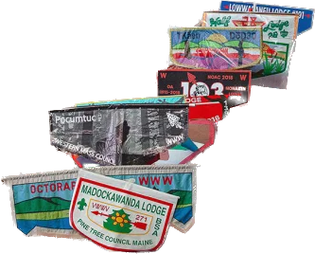
NOAC Committees
FUNDRAISING: Plan the OA Banquet Cake Auction and research other fundraising ideas for the Contingent.
ACTIVITIES: Research and gather costs for pre-NOAC activities that the Contingent can participate in based on interest from this survey.
SWAG: Collaborate, design and price various merchandise for the contingent to receive. Ideas will be narrowed down by this survey. This Committee has some of the most important due dates to get patch designs to production! Please be prepared to help finalize over Christmas Break!
HOSPITALITY: Based on the direction we go with our pre-NOAC activities this committee will plan and gather costs for transportation, accommodations, and food.
Looking for Youth Chairs for these Committees!

Slide 5
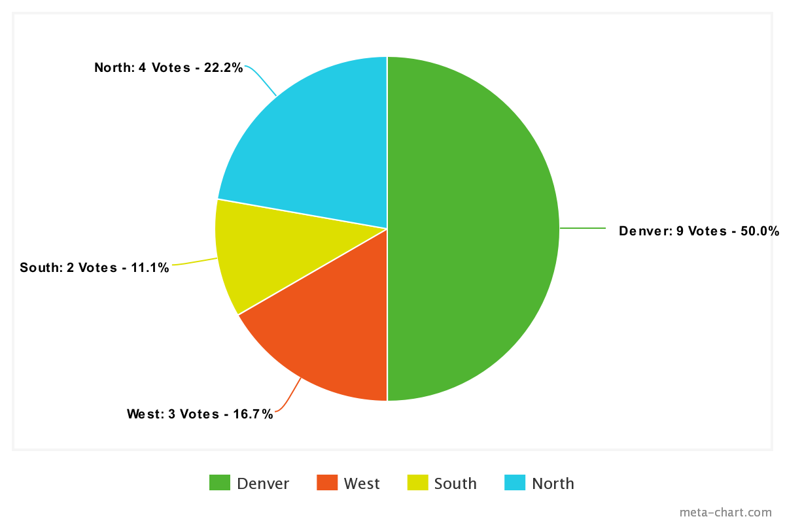
Activities Committee
Overview:
Review Who is on the Committee
Choose a Youth Lead
Ensure Adequate Adult Advisers
Discuss Results from Google Form
Choose 2 Directions to Research
Expectations for January Meeting:
Research the Activities in both Areas
Come up with an Itinerary for each Area – Time Allotted & Order
Identify Costs
Identify Waivers & Reservations or Down Payments
5 - AD

Slide 6
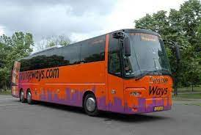
Pre-NOAC Activity Ideas
In Denver
West
North
Red Rocks/Concert
Science Museum
Planetarium
Aquarium
Zoo
Elitches
Downtown Golden Tubing
Night Program?
Safari
Wings Over the Rockies
Mining Tour - Henderson, Idaho Springs, Cripple Creek & Victor
Clive Cussler Car Museum
Denver Mint
No Rockies Games : (
Horseback/Continental Divide
Rafting
Winterpark - Mountain Biking, Tubing (1.5 hrs)
Zipline
Rocky Mountain National Park (2.5 hrs)
St. Mary’s Glacier Tour
Cheyenne Frontier Days
Old Frontier Town
Bull Riding
Shows
Service at CFD - Pancake Breakfast
Other sites around Cheyenne
South
Mesa Verde Ruins (7 hrs)
NRA Whittington Center (3 hrs)
Los Alamos
Florissant Fossil Beds (.5 hr)
Garden of the Gods
Canyon City - Royal Gourge
Great Sand Dunes & Falls
9 - LP

Slide 7
Hospitality Committee
Overview:
Review Who is on the Committee
Choose a Youth Lead
Ensure Adequate Adult Advisers
Based on 40, 60, 80 Delegates
Expectations for January Meeting:
Research the Types of Transportation for each Area – Bus, Van, etc.
Provide Costs for each Solution by Capacity
Identify Waivers & Reservations or Down Payments
6 - AD

Slide 8
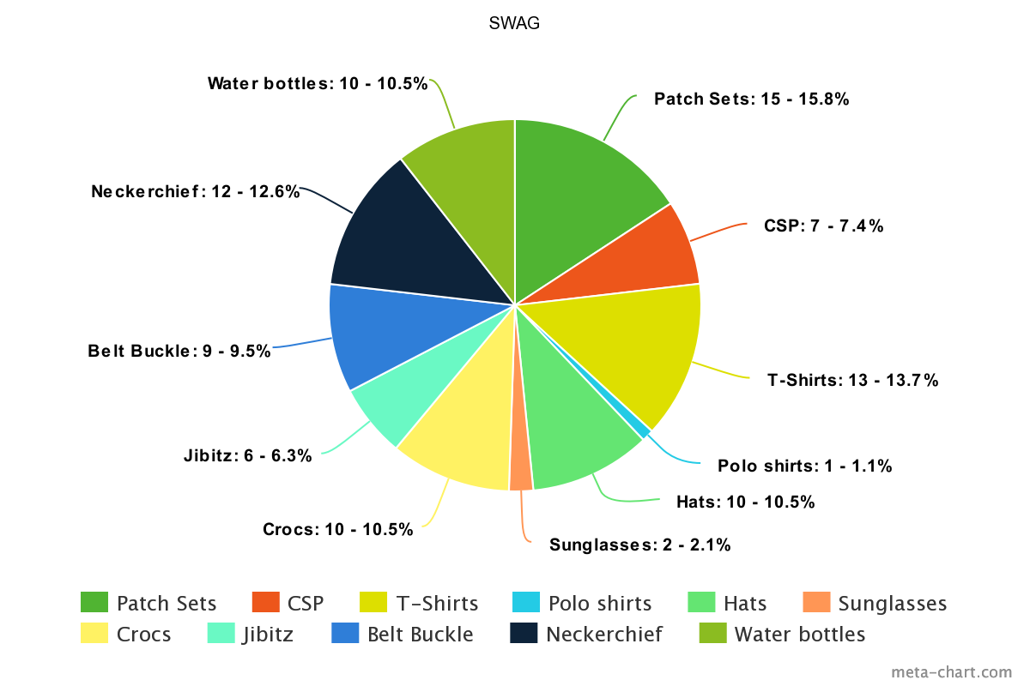
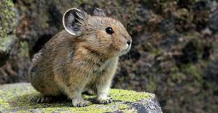
SWAG Committee
Overview:
Review Who is on the Committee
Choose a Youth Lead
Ensure Adequate Adult Advisers
Reduce Number of Items to 6
Brainstorm Ideas for Committee to Use
Expectations for January Meeting:
2-3 Designs Prepped for January Meeting Vote
Research the Types of SWAG and Cost Range for 50, 100, 200

Slide 9
SWAG Committee
Patch Design NEEDS to Happen Over Winter Break!
Theme: Seek New Heights
Colors: Orange & Purple
Ideas: Colorado 14er’s
Other . . .
Possible Vendor Collaboration: Otter Box or Chipotle

Slide 10
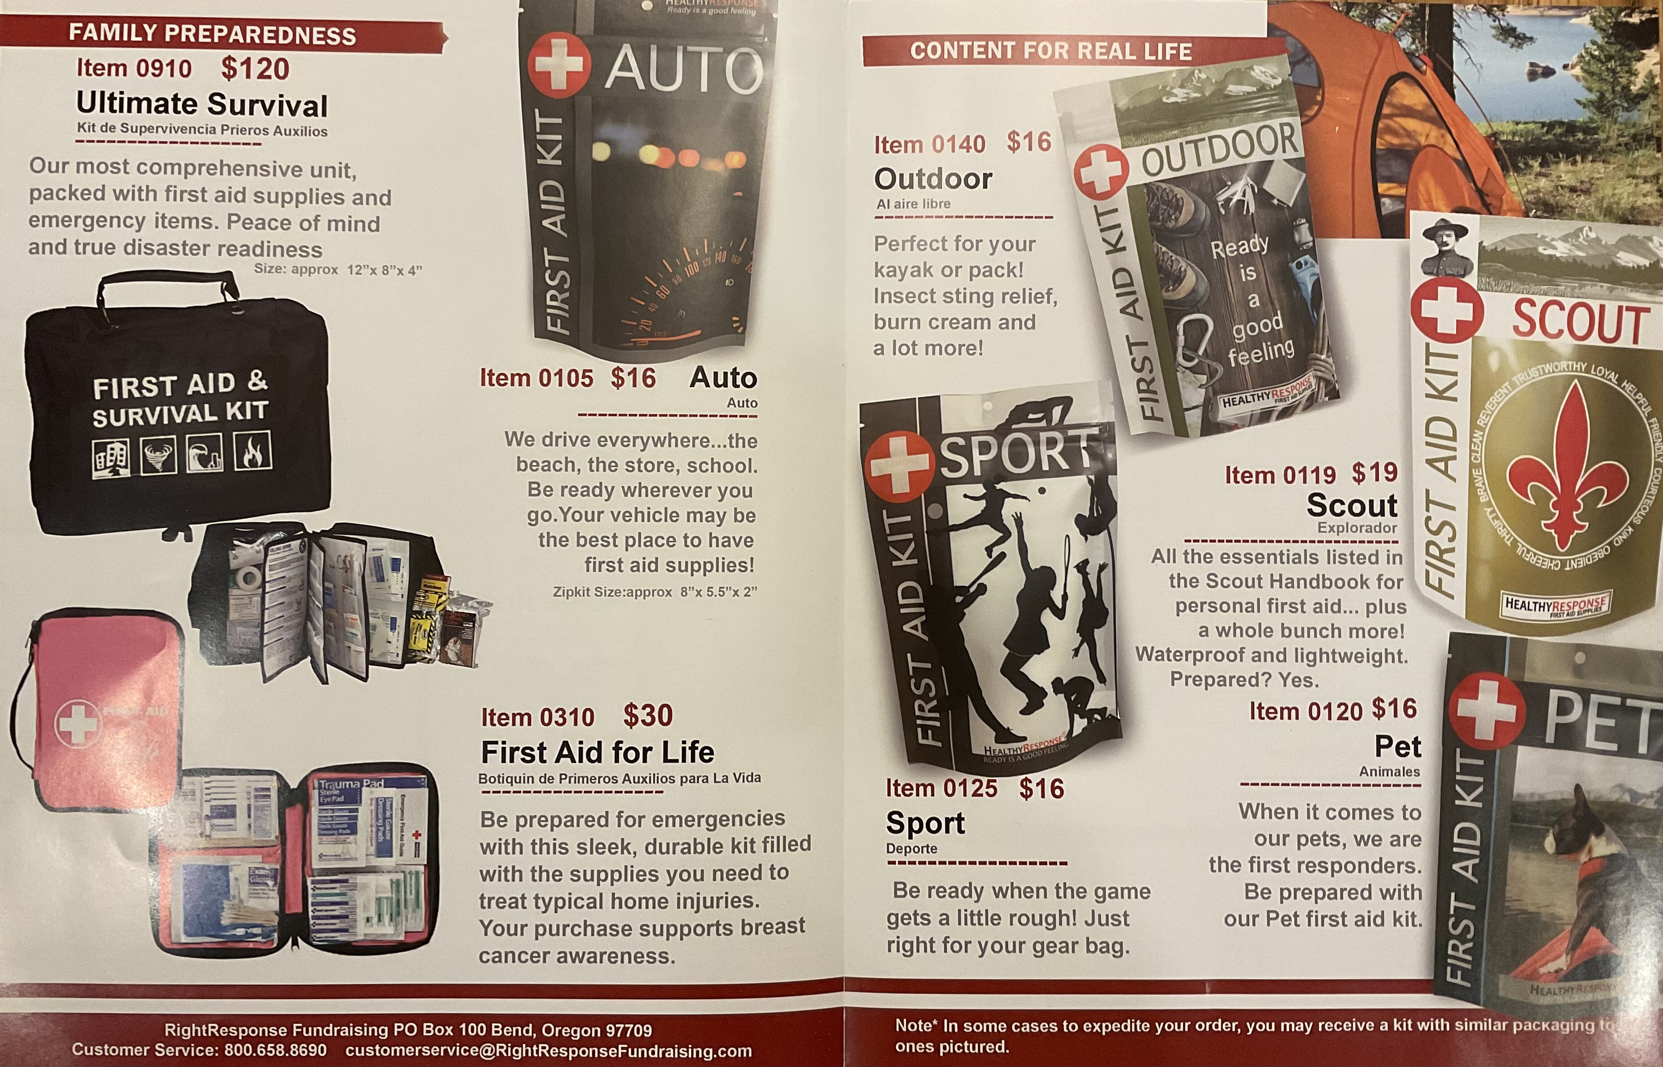
Fundraising
GCC Camp Cards
Right Response First Aid Kits
Online Sales Receive 40%
1 Email Address per Family
OA Banquet Cake Auction
Everyone that Participates Gets
Divided Funds
GCC Camp Cards
Sign-up Through Your Unit

Slide 11
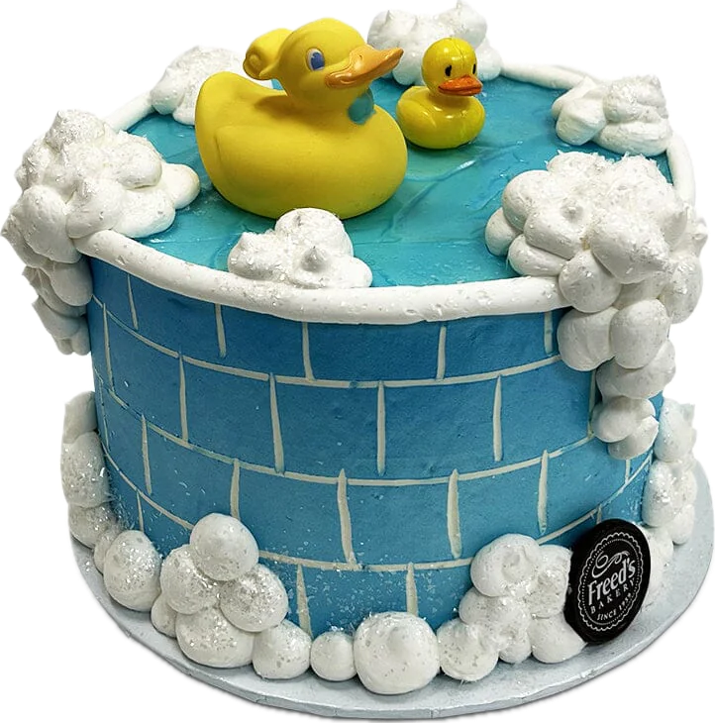
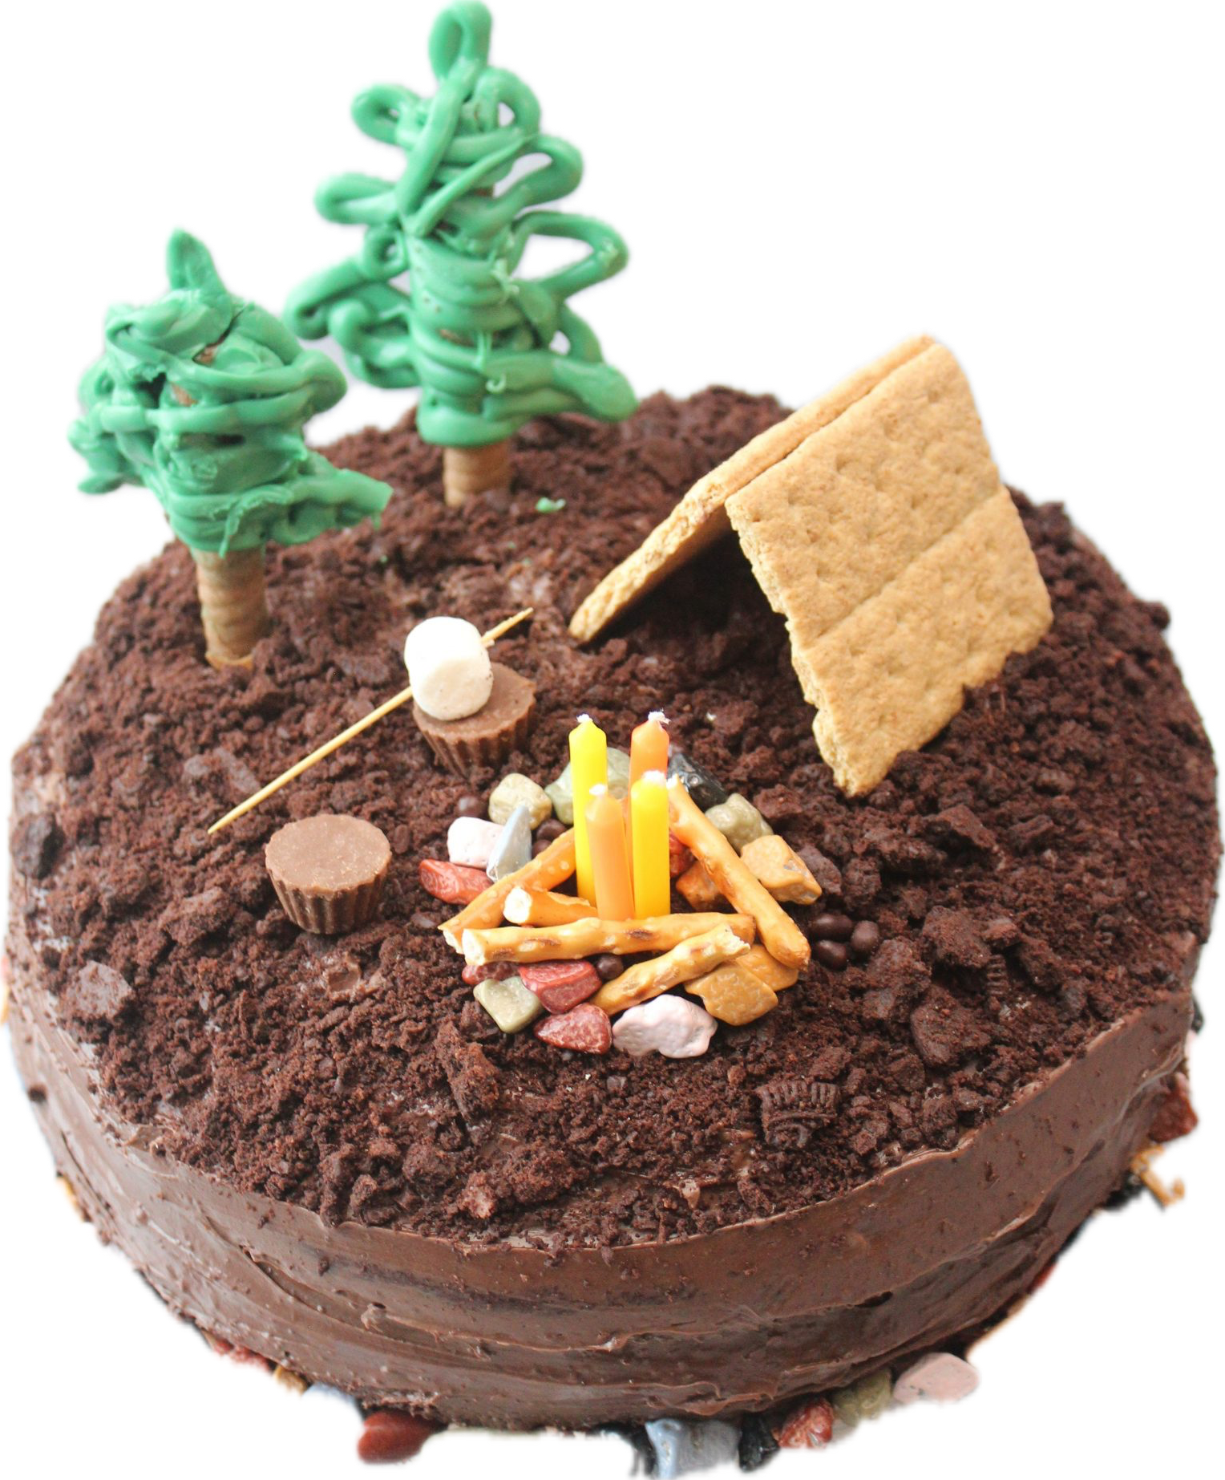
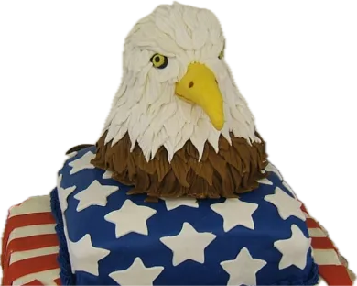
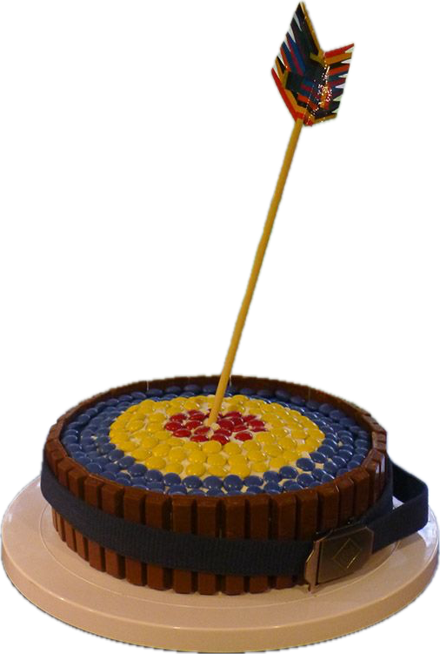
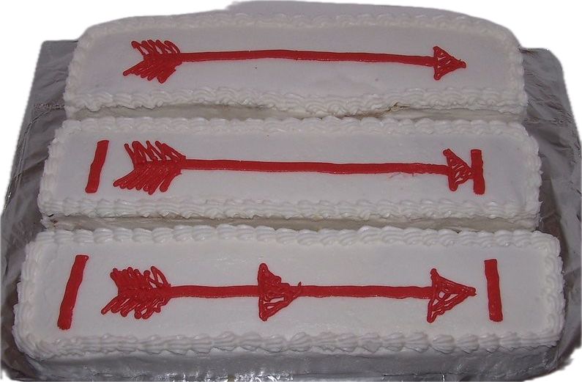
Fundraising Committee
Overview:
Review Who is on the Committee
Choose a Youth Lead
Ensure Adequate Adult Advisers
Expectations for January Meeting:
Create Promotional Materials for Lodge to Participate (Email, Instagram)
Create a Sign-up Genius
Work with Activities VC to Put a Plan Together for the Cake Auction (Tables, Table Clothes, Program)
Work with Admin VC to Determine How People can Pay for Cakes
Possible Raffle Item for Cake Entries

Slide 12
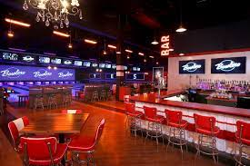
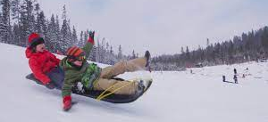
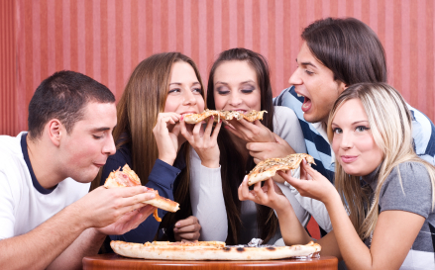
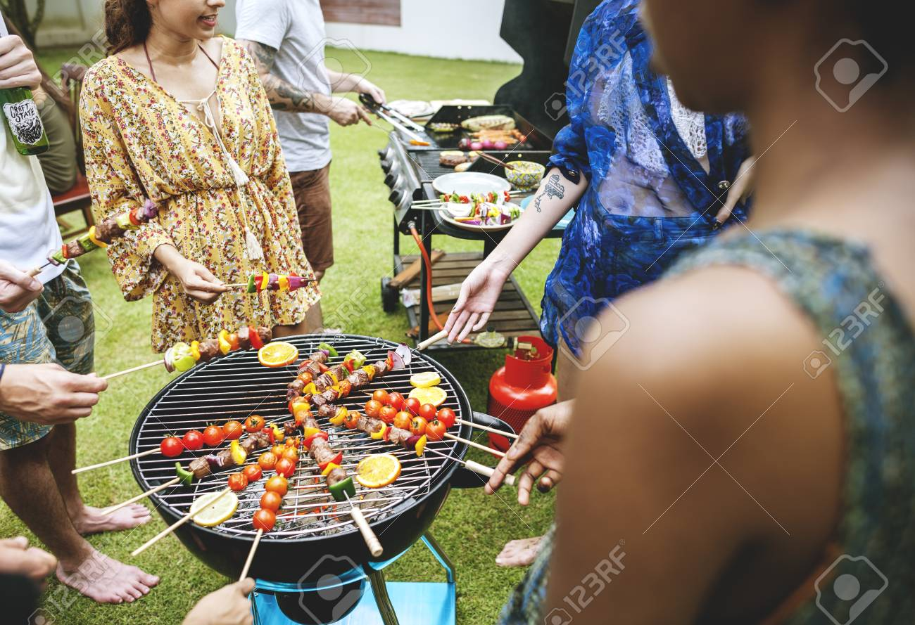
Contingent Winter Break Get Together
Select Activity for Winter Break:
- Go Bowling / Pool / Air Hockey
- Go Ice Skating
- Meet at a Restaurant
Choose Date:
- Friday December 29

Slide 13
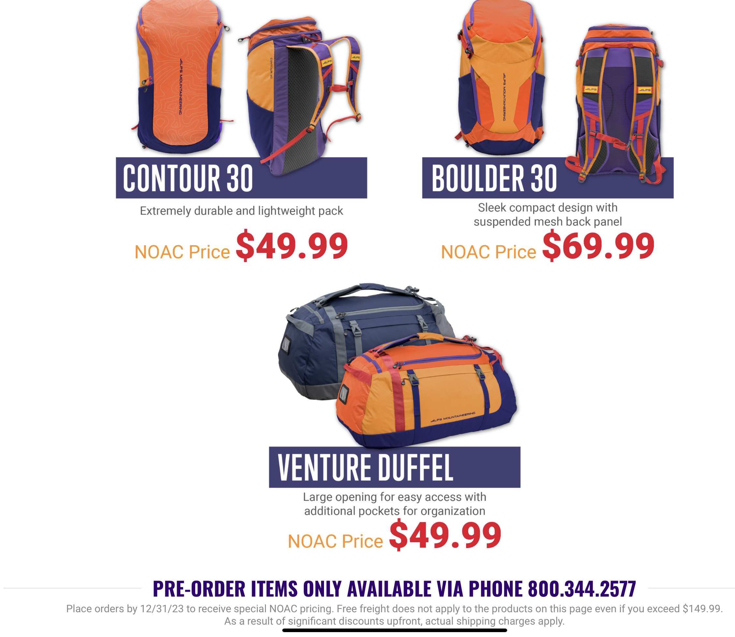
Alps Mountaineering
https://alpsmountaineering.com/noac-2024
13 - LP

Slide 14
14 - LP

Slide 15
Youth Applications due Jan. 31 https://oa-bsa.org/program/events/noac/trailblazer-scholarship Adult Sponsors
OA Trail Blazer Scholarship
The memorabilia package* includes the following special items:
- Trailblazer Neckerchief - Trailblazer Patch
- Trailblazer Chenille - Trailblazer Coin
- Trailblazer Pin
Every individual supporter of the Trailblazer Scholarship who purchases at least one memorabilia package AND registers to attend NOAC will be invited to an exclusive sponsor reception at the conference.

Slide 16
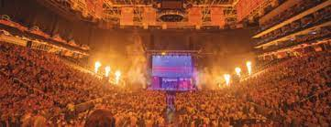
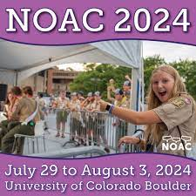
Advertise
Go Back to your Unit:
- Share Info with Your Scoutmaster
- Promote OA Elections in Spring
- Wear Your NOAC 2024 Patch
- Promote Attending NOAC
- Invite a Fellow Arrowman!

Slide 17
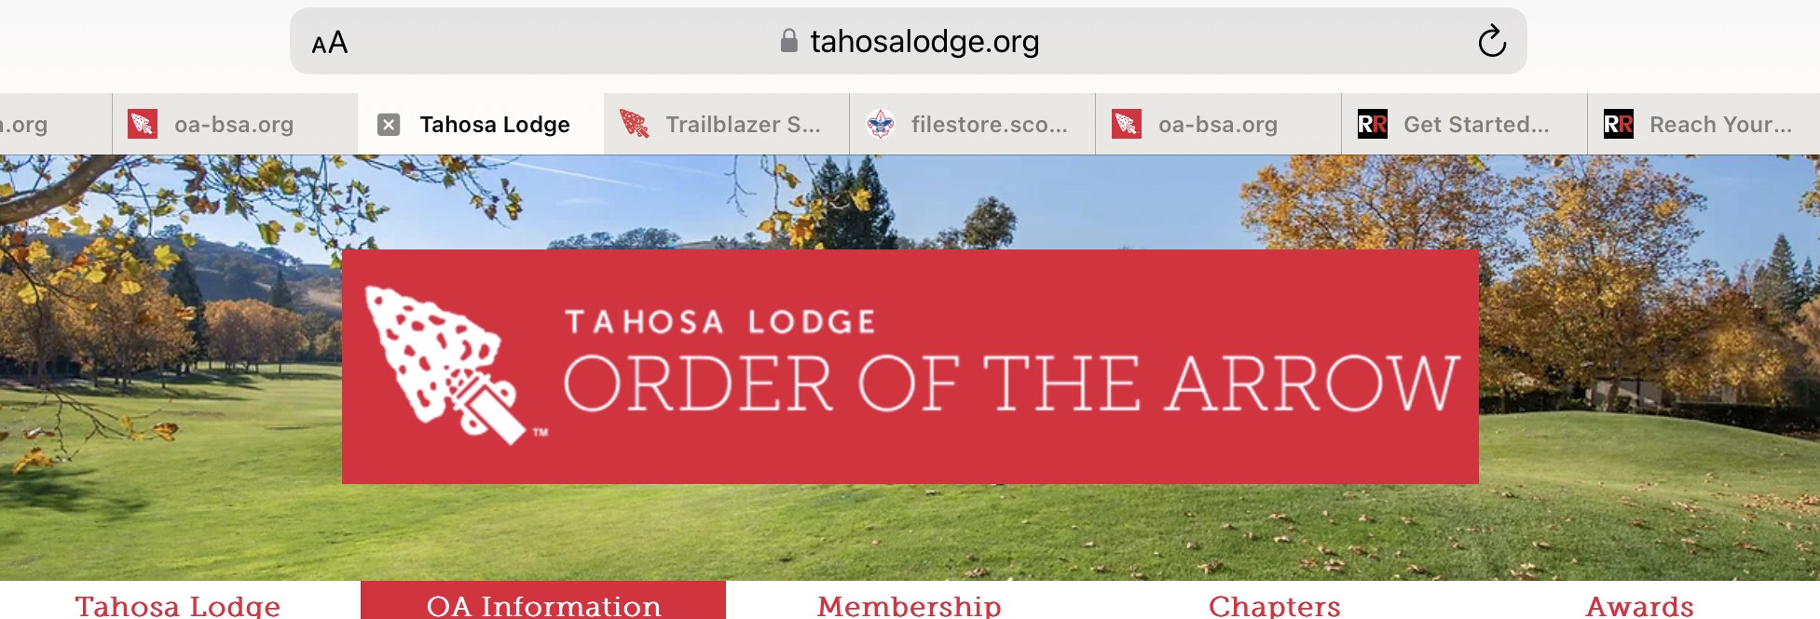
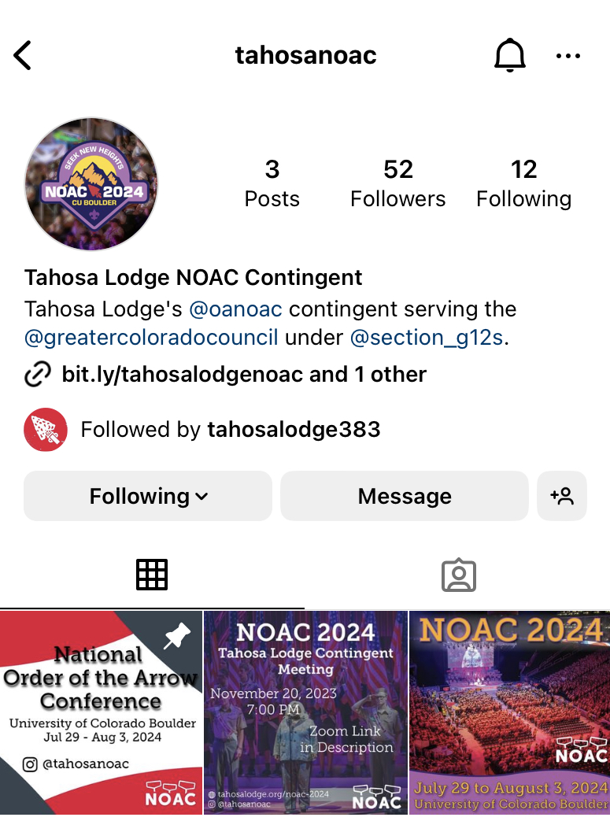
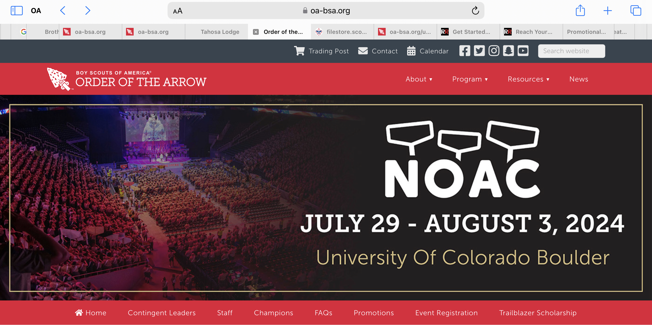
NOAC Info
Tahosa Website – NOAC Page
Doubleknot to make Payments
https://www.tahosalodge.org/noac-2024
OA NOAC Website
https://oa-bsa.org/program/events/noac
Instagram Handles
@tahosanoac and @oanoac
Lodgemaster Emails
Mass communications for the contingent
Contingent Communication
Slack App (for those Registered with the
Contingent)
NOAERS
For Registered Contingent Delegates to Sign-
up for training and activities at NOAC

Slide 18
Seek new heights together at NOAC 2024!
?’s
Next Contingent
Meeting
1/14 @ 7:00 pm

Slide 19
THANK YOU fOR YOUR tIME AND SUPPORT

